Slide 1

Deep K-TSVM: A Profiled Power Side-Channel Attack on AES-128
Paper Presentation by
Name: Mahbub Hasan Reg: 09580 ID :2002063 Date: 20 Jan 2026

Slide 2

What is Cryptography and AES?
Cryptography is the science of protecting secret data.
Encryption transforms data into an unreadable format using a secret key.
AES (Advanced Encryption Standard) is a widely adopted symmetric encryption algorithm.
AES is integral to secure communications in Wi-Fi, banking, smart cards, and various hardware devices.
AES-128 utilizes a 128-bit key for robust encryption.

Slide 3

Understanding AES-128
1
2
Key Size
Key Representation
AES-128 employs a 128-bit encryption key, providing a high level of security.
The 128 bits are typically represented as 16 bytes, forming a sequence from K1 to K16.
3
4
Encryption & Decryption
Data Confidentiality
This key is essential for both encrypting plaintext into ciphertext and decrypting ciphertext back into plaintext.
Without the correct 128-bit key, encrypted data remains inaccessible and unreadable, ensuring confidentiality.
Example: AES Key = [K1 | K2 | K3 | … | K16]

Slide 4

What is a Side-Channel Attack?
A side-channel attack is a non-invasive technique that exploits information unintentionally leaked by a device during its operation.
Does not target the algorithm: Unlike cryptographic attacks that attempt to break the mathematical foundations of an algorithm, side-channel attacks observe physical phenomena.
Exploits Physical Leakage: These attacks leverage unintended physical emissions or characteristics from the device implementing the cryptography.
Common Leakage Examples:
Power Consumption: Analyzing the fluctuating power draw of a device as it performs cryptographic operations.
Timing Analysis: Measuring the precise time taken for operations, which can vary based on secret data.
Electromagnetic (EM) Signals: Detecting electromagnetic radiation emitted by the device, which can carry information about internal processes.
Goal:
The primary objective is to recover the secret encryption key by analyzing these incidental physical leakages.

Slide 5
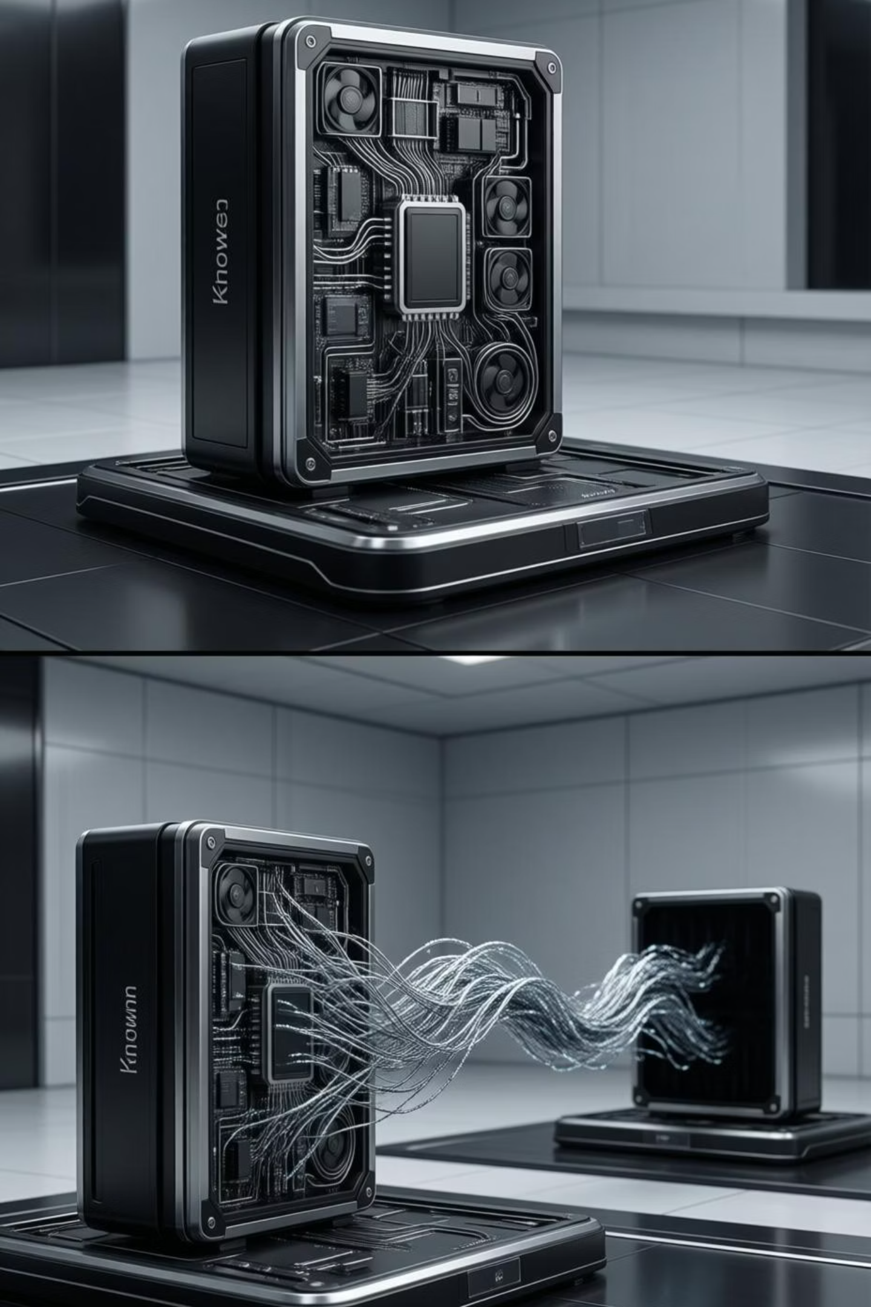


Profiled Side-Channel Attacks: Two Phases
1. Training (Profiling) Phase
Attacker has an identical device.
Many power traces are acquired.
The secret key for this device is known.
A machine learning model is trained using this data.
2. Attack Phase
A limited number of traces are collected from the victim device.
The pre-trained model from the profiling phase is deployed.
The secret encryption key is successfully recovered.

Slide 6

Challenges with Previous Methods
High Trace Count: Traditional side-channel attacks often require a substantial number of power traces to achieve successful key recovery.
Noise and Misalignment: Environmental noise and temporal misalignments in traces significantly degrade attack accuracy.
Masking Resistance: Masking and other cryptographic countermeasures are designed to obscure leakage, making attacks more difficult.
The Need:
To overcome these challenges, new methods are required that can perform effectively with fewer traces, maintain high accuracy, and succeed against masked AES implementations.

Slide 7
Goal of This Paper
Novel Attack Design
Hybrid Approach
Versatile Application
Develop a new deep learning-based side-channel attack methodology.
Integrate deep learning with Support Vector Machines (SVM) for enhanced performance.
Effectively attack both masked and unmasked AES-128 implementations.
Minimal Traces
one power trace.
Achieve secret key recovery using a very small number of power traces.
Demonstrate successful key extraction even with just one available power trace.

Slide 8
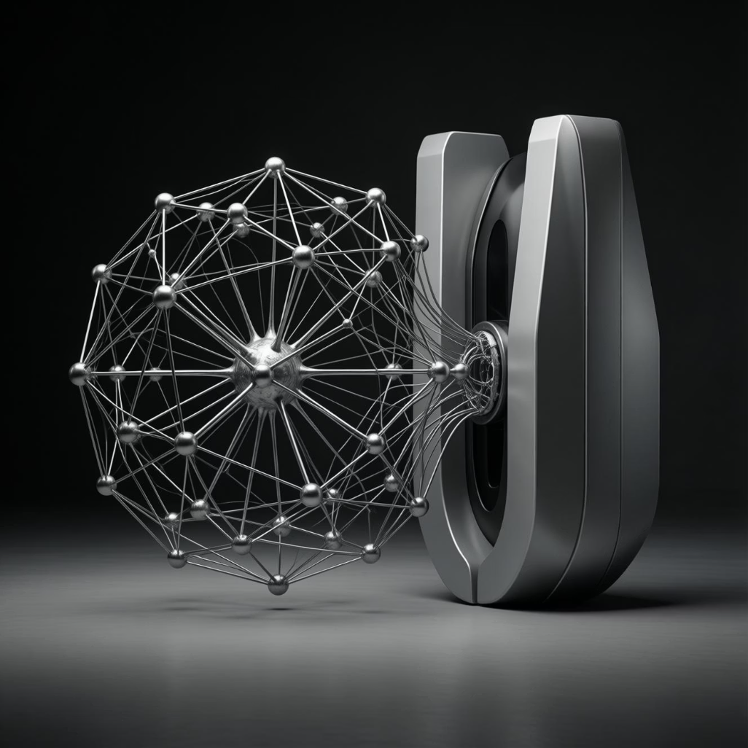
Proposed Model: Deep K-TSVM
The research introduces a novel model named:
Deep K-TSVM
Which stands for Deep Kernel Learning Twin Support Vector Machine.
Core Idea:
This approach combines the power of deep learning for feature extraction with
the robust classification capabilities of Twin Support Vector Machines.
Two Principal Modules:
Feature Extraction Module: Responsible for processing raw power traces and extracting relevant, discriminative features.
Classification Module: Utilizes the extracted features to classify potential key bytes, ultimately recovering the secret key.

Slide 9

Feature Extraction Using Restricted Boltzmann Machine (RBM)
RBM Integration: The feature extraction module primarily employs a Restricted Boltzmann Machine (RBM).
Pattern Learning: RBMs are adept at learning complex patterns and representations directly from raw power traces.
Noise Reduction & Feature Selection: This process effectively filters out noise and extracts only the most salient information relevant to the cryptographic operation.
Layer-by-Layer Pre-training: The RBM undergoes a pre-training phase, where each layer learns incrementally, optimizing its weights and biases.
Improved Performance: This pre-training strategy significantly enhances the model's accuracy and its ability to generalize effectively to new, unseen data.

Slide 10

Classification Using Twin SVM
Our approach leverages a Twin Support Vector Machine (TSVM) for robust classification. Unlike traditional SVMs, TSVM constructs two non-parallel hyperplanes, each optimized to classify data points from a specific class while maximizing the margin from the other.
Builds two separating hyperplanes, significantly enhancing classification efficiency.
Offers superior speed compared to conventional Support Vector Machines.
Employs a one-versus-all strategy for effective multi-class classification.
Performs 256-class classification to determine a single key byte in AES-128.

Slide 11




Byte-Wise Attack Idea
The AES-128 key consists of 16 bytes. Our attack strategy targets these bytes individually, simplifying the complex
task of key recovery.
1. AES-128 Key Structure
2. Sequential Byte Attack
The AES-128 key is composed of 16 distinct bytes.
The attack proceeds one byte at a time, minimizing computational load.
3. Exhaustive Byte Values
4. Iterative Key Recovery
Each byte can take 256 possible values (0-255), representing all permutations.
The model first guesses one byte, then repeats the process for the remaining 15 bytes until the full key is recovered.

Slide 12
How is Key Rank Calculated?
Key rank is a critical metric for evaluating the success of a side-channel attack. It quantifies how high the correct key ranks among all possible guesses.
Calculation Steps:
Key Rank Significance:
For each key guess k, compute L = SBox(P ⊕ k), where P is plaintext.
The position of the correct key in the sorted list determines its rank.
Extract the probability associated with class L from the model's output.
A rank of 1 indicates a perfect, immediate guess of the key.
Aggregate (add) probabilities for all attack traces.
A rank of ≤ 10 signifies a very strong and successful attack, recovering the key with minimal effort.
Sort all 256 accumulated scores in descending order to establish their ranks.

Slide 13

Datasets Used
To rigorously test and validate our model, we utilized two widely recognized public datasets, ensuring our results are comparable and reproducible within the security research community.
ASCAD Dataset:
Masked AES-128 Implementation: Features traces from a protected AES implementation.
Training Traces: Comprises 50,000 power consumption traces for model training.
Attack Traces: Includes 10,000 traces specifically for testing attack effectiveness.
TeSCASE Dataset:
Masked and Unmasked AES: Provides data from both protected and unprotected AES versions.
Extensive Trace Count: Features a substantial number of traces, suitable for diverse testing scenarios.

Slide 14




Advantages of This Method
The Deep K-TSVM model offers significant advantages over existing side-channel attack techniques, setting a new benchmark for effectiveness and efficiency.
Exceptional Accuracy
Achieves very high accuracy in key byte prediction, minimizing false positives.
Low Trace Requirement
Requires very few power traces for successful key recovery, enhancing stealth.
Versatile Application
Effective against both masked and unmasked AES implementations.
Strong Generalization
Benefits from pre-training, leading to excellent generalization across different devices.

Slide 15

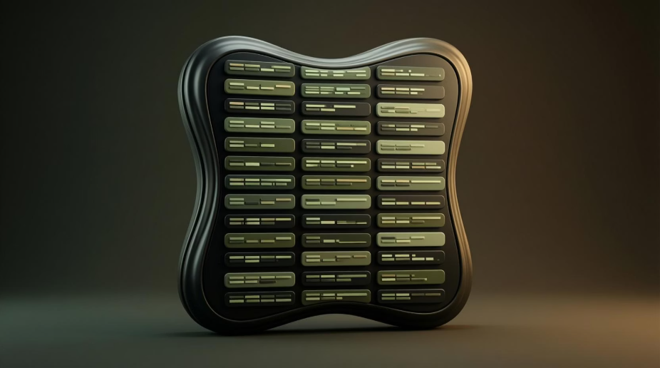

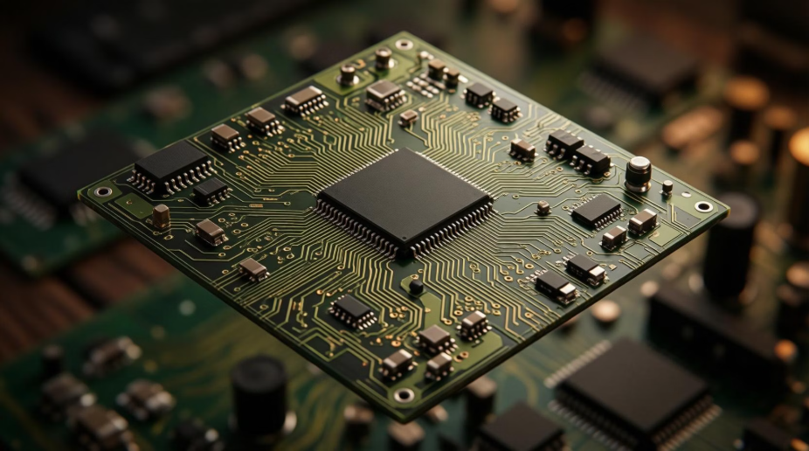
Limitations of This Work
While promising, our current work acknowledges several limitations that provide clear avenues for future research and development in side-channel analysis.
Profiled Attack Nature
Extensive Training Data
The methodology requires a copy of the target device for profiling, limiting non-profiled attack scenarios.
The training phase necessitates a large number of traces to build a robust and accurate model.
one key byte is shown in experiments
Real-World Complexity
Experiments primarily demonstrate key recovery for only one key byte, requiring further validation for all 16 bytes.
Real-world attack scenarios may present higher noise levels and additional protections, potentially impacting performance.

Slide 16










Conclusion
This research introduces a powerful new model that significantly advances the field of side-channel analysis, highlighting the growing threat of deep learning to hardware security.
Hybrid Approach
New Deep K-TSVM
Combines Restricted Boltzmann Machines (RBM) with Twin SVM.
Proposed a novel Deep K-TSVM model.
High Accuracy
Security Implications
Recovers key bytes with exceptional accuracy.
Demonstrates deep learning as a significant threat to hardware security.

Slide 17

Questions & Discussion
I welcome your questions and insights. Let's delve deeper into the implications and potential applications of this research.

Slide 18
Thank You
I appreciate your time and attention today. For further inquiries or collaborations, please feel free to reach out.

